Slide 1

Dr. Sajid Iqbal
Department of Computer Science
Bahauddin Zakariya University, Multan

Slide 2
Lecture Contents
What are input devices
Manual and Touch Input Devices
Body, Skin and Gesture Input Devices
Image and Video Input Devices
Biometric Input Devices
Voice Input Devices
Virtual Reality Input Devices

Slide 3
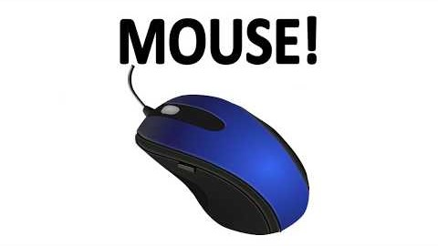
What are input devices
A piece of equipment used to provide data and control signals to an information processing system such as a computer or information appliance
Input devices can be categorized differently considering its different features. For example
Manual and automatic input devices
Discrete and continuous input devices
…

Slide 4
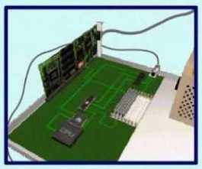
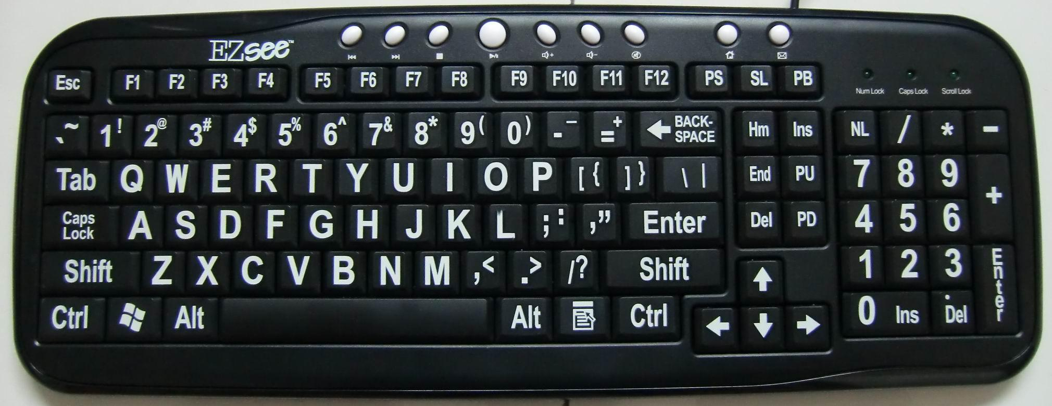
Manual Input Devices
The devices which allow the direct interaction of user
A key board consists of number of keys (buttons)
Different keys performs different tasks with different applications
For example
Tab is used to take the cursor some defined positions ahead
Backspace used to remove a character

Slide 5
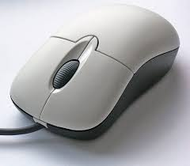
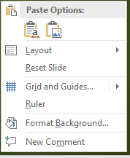
Pointing Devices
Mouse: It is used to point a location on output screen and then allows interaction with it.
Current mouses usually consists of two upside buttons
Left mouse button is usually used to select something
Right mouse button usually displays a pop up menu from which different actions can be chosen
The pop up menu may change depending upon where and right click is done
The upside wheel is used to scroll the screen
There are variety of models have less or more functionality

Slide 6
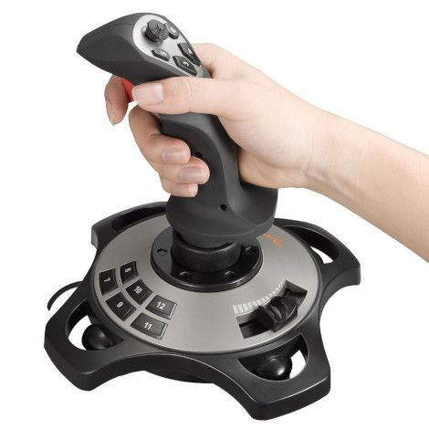
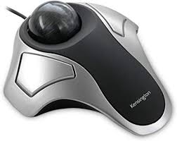
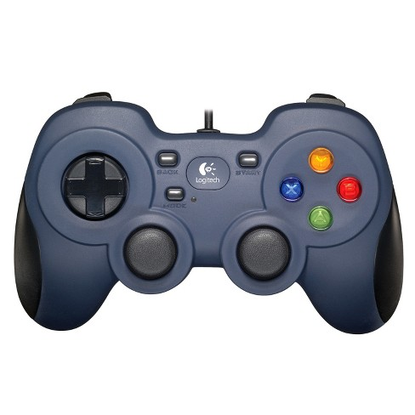
Pointing Devices
Joystick:
It consists of long upheld stick called handle
It gives the direction in which handle is moved to the software
Usually these are used in video games
It also contains some buttons on it
The function of each button is specified by the game that you are playing
Trackball
It contains a ball held in socket.
By moving ball in different directions, one can move the mouse on screen
Gamepad
This input devices is used to play games
Different buttons performs different tasks based on game being palyed

Slide 7
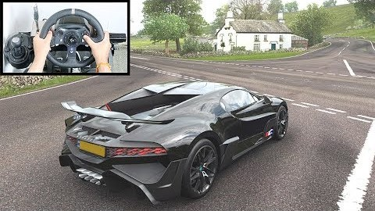
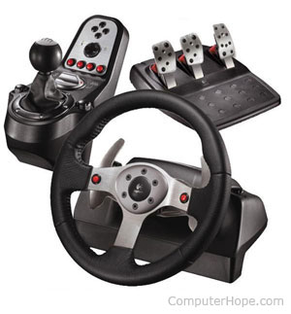
Pointing Devices
Steering wheel and pedal
To provide real driving experience in games, steering wheels are used
To simulate the effect of brakes, acceleration and clutch etc, pedals are used

Slide 8
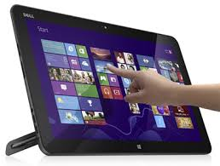
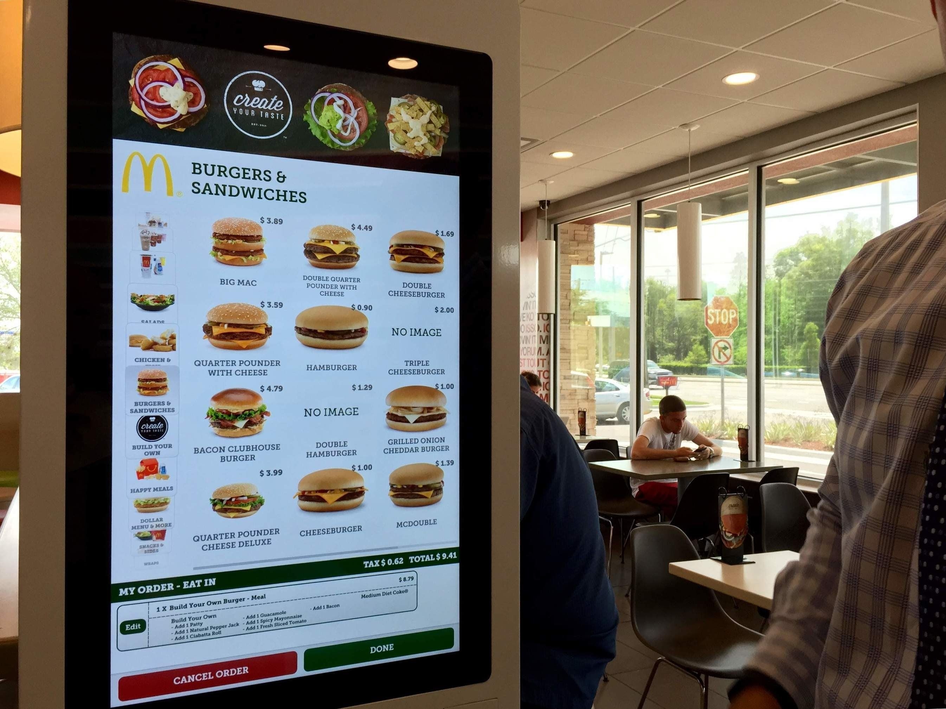
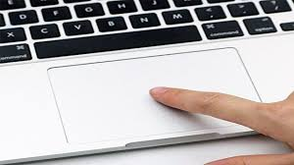
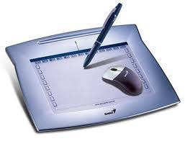
Touch Input Devices
You can provide input to computer by touching these devices only
Touch Screens
Touch screen computers, laptops, smart phones, ATM machines, Larger displays in markets
There are multiple uses of touch screen like in business, education, entertainment etc.
Touch Pad
This devices translates the motion made on it
To electrical signals. Works like mouse

Slide 9
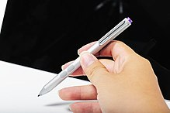
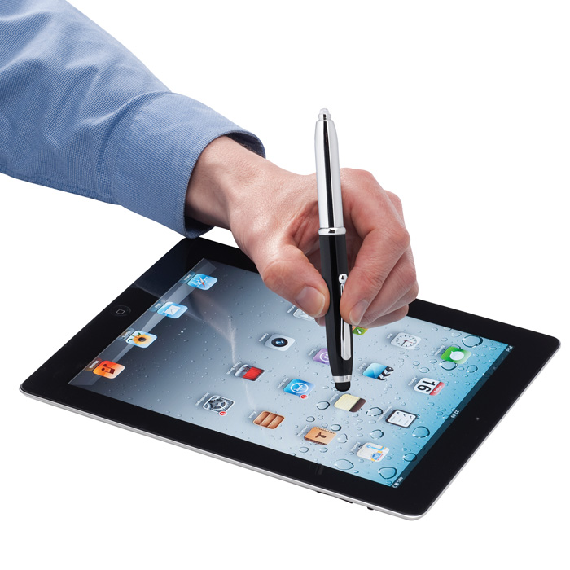
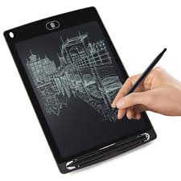
Light Pen based Input
Digital pen:
It captures the analog handwriting or brush strokes of a user and converts into digital data, enabling the data to be utilized in various applications
Smart pen
It is similar to digital pen but has more features like text scanning and voice recording
Light pen
A pen like input devices which is light sensitive and is used to give input to computer by touching its screen
Text pads
This is the metal or glass surface upon which using light pen, text could be written
Graphic pads
It enables a user to hand-draw images, animations and graphics, with a special pen-like stylus, similar to the way a person draws images with a pencil and paper.

Slide 10
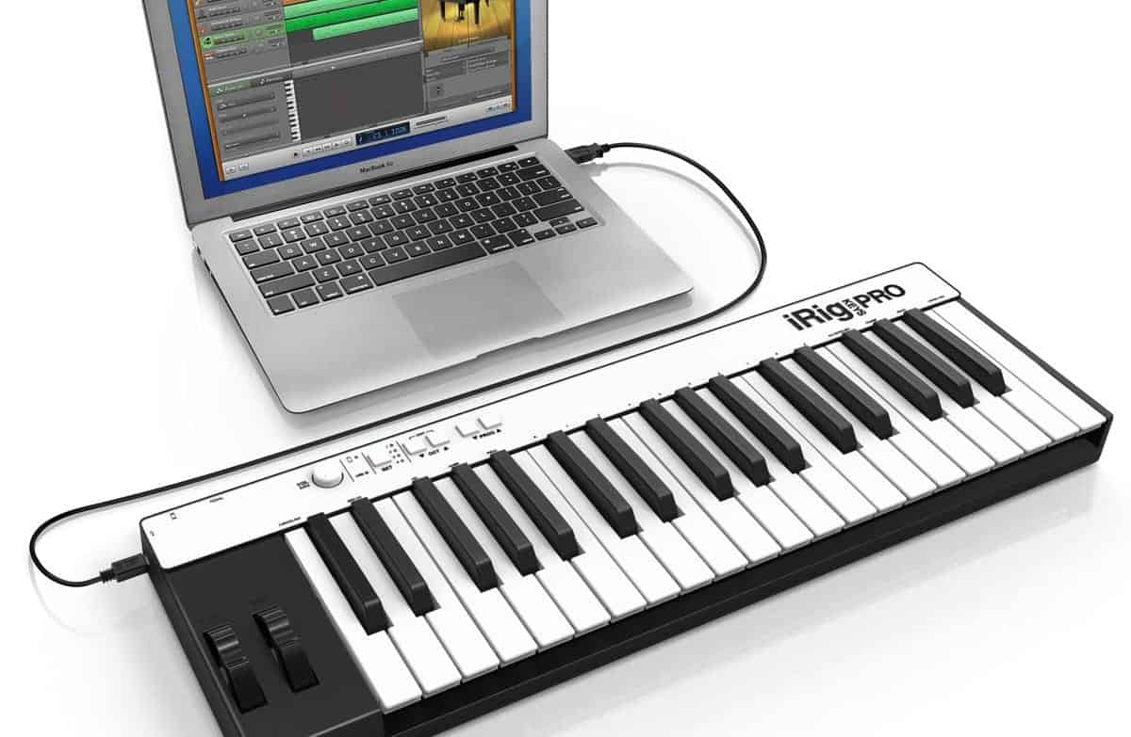
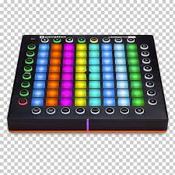
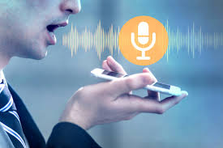
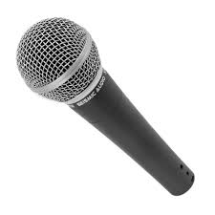
Voice/Sound Input Devices
MIDI or Voice Keyboard:
It is a piano style electronic musical keyboard
Digital Musical Instruments
Microphone
It is very common audio input device
Voice Recognition System
Computer dictation
Voice based identification

Slide 11
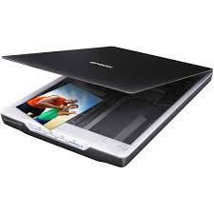
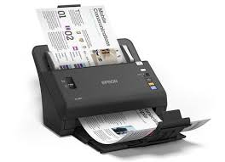
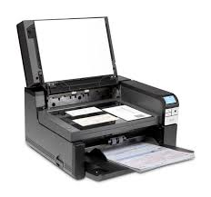
Image Input Devices
Image Scanner
It optically scans images, printed text, handwriting or an object and converts it to a digital image.
Flatbed scanner: This scanner uses flat surface for document scanning
Sheet-fed scanner: image is fed through the scanner and moves along the beam to be read rather than the beam moving
Integrated Scanner: A scanner which is built as part of some other device

Slide 12
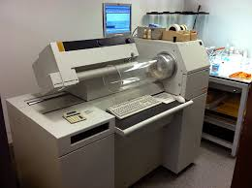
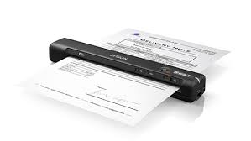
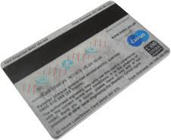
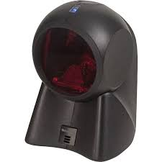
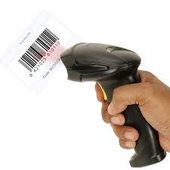
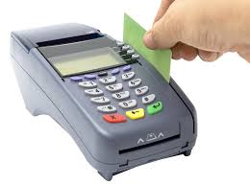
Image input devices
Drum Scanner: These scanners are used to capture image and produce images at very high resolution
Portable Scanner: The handy scanners that you can carry to capture text, codes and images
There are number of other types of scanners that include
Card Scanners: They read either chip or magnetic strip of card
Bard Code Readers:

Slide 13
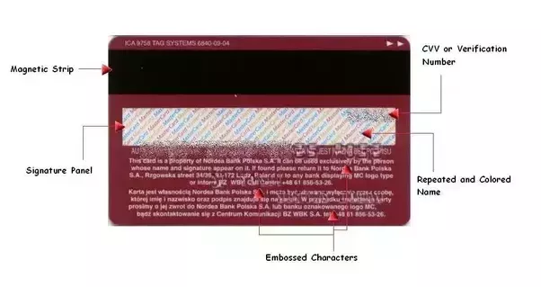
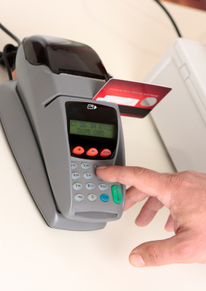
Input Methods
Magnetic Strip Card:
A magnetic stripe card is capable of storing data by modifying the magnetism of tiny iron-based magnetic particles on a band of magnetic material on the card

Slide 14
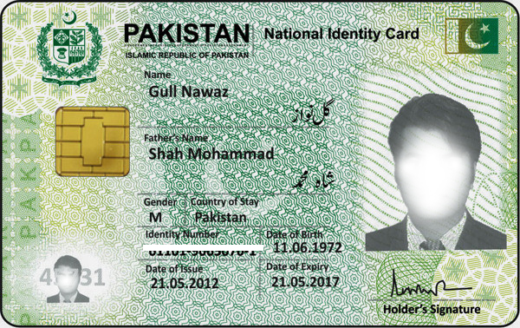
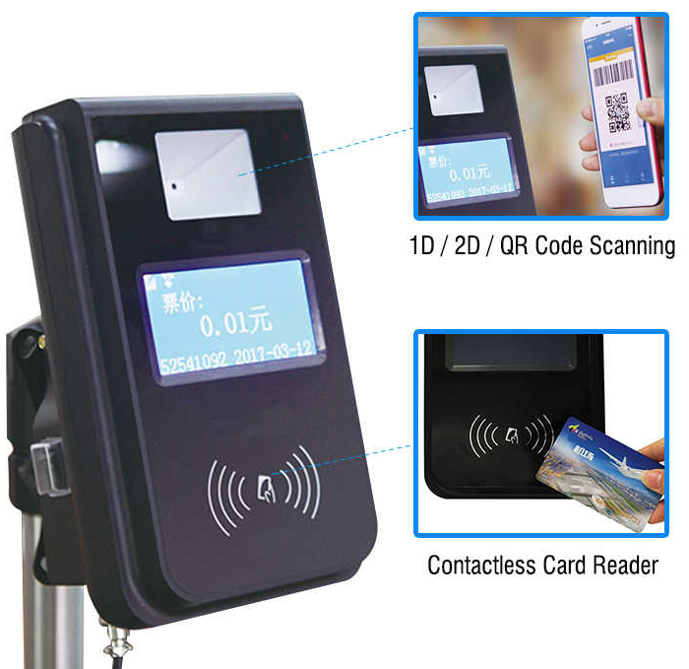
Smart Cards
It is a physical electronic authorization device, used to control access to a resource.
It is typically a plastic credit card-sized card with an embedded integrated circuit chip

Slide 15
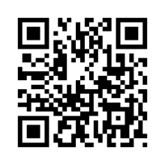
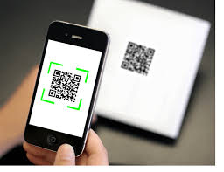
Quick Response (QR) Code
A QR code is a type of matrix barcode (or two-dimensional barcode) first designed in 1994 for the automotive industry in Japan
A barcode is a machine-readable optical label that contains information about the item to which it is attached
QR codes often contain data for a locator, identifier, or tracker that points to a website or application
There are several standards that cover the encoding of data as QR codes

Slide 16
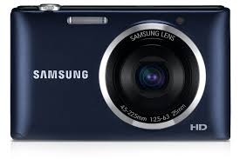
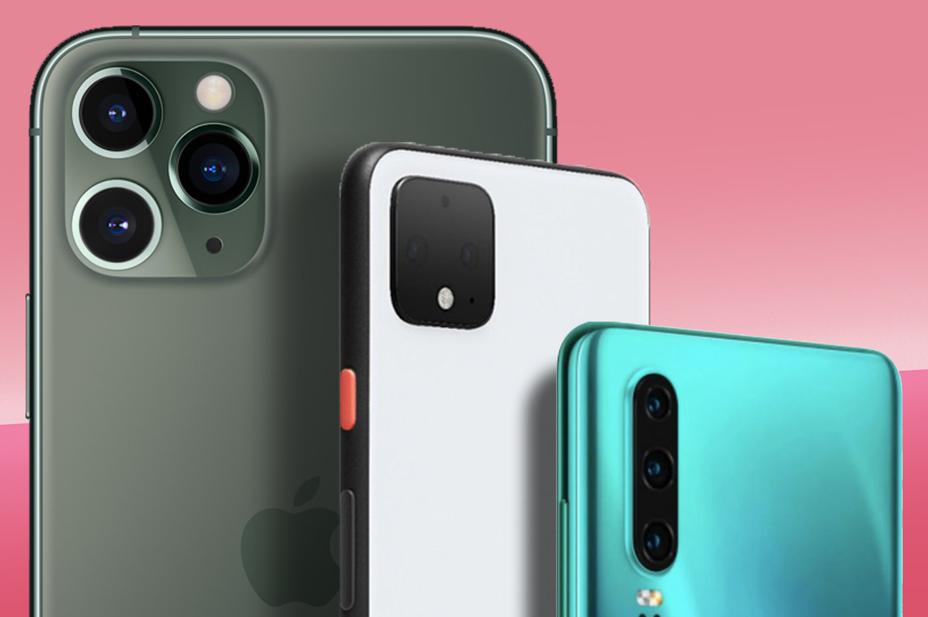
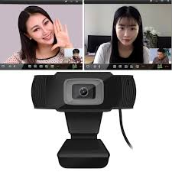
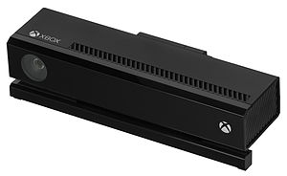
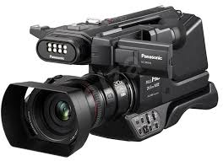
Video Input Devices
Digital Camera
It is very well known device especially with smart phones
Digital camcorder
It can perform the video recording and image capturing
Webcam
A web camera is a camera that can capture the video streams
Microsoft Kinect
It can perform real-time gesture recognition, speech recognition and body skeletal detection for
up to four people

Slide 17
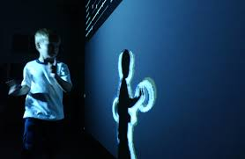
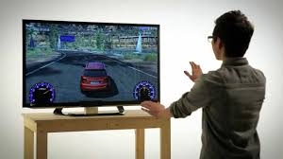
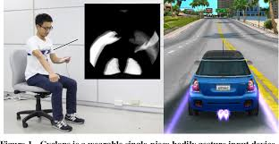
Body Gesture Input
It interprets human gestures via mathematical algorithms
Gestures can originate from any bodily motion or state but commonly originate from the face or hand
Emotion recognition from face and hand gesture recognition
Many approaches have been made using cameras and computer vision algorithms to interpret sign language
The identification and recognition of posture, gait, proxemics, and human behaviors also lies in gesture recognition

Slide 18
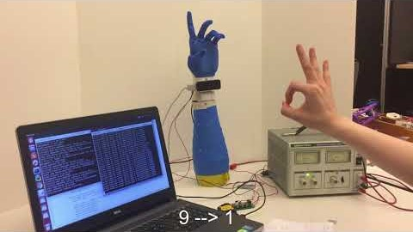
Gesture Recognition

Slide 19
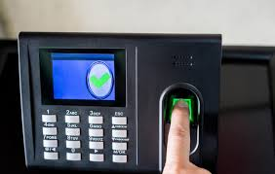
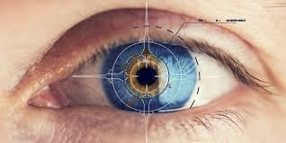
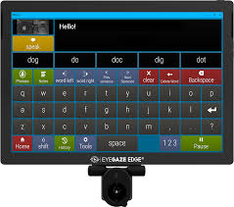
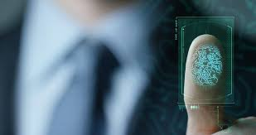
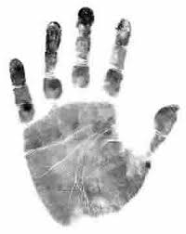



Biometric Inputs
The device that identifies the person based on its body characteristics
These inputs include
Finger input
Thumb recognition
Face recognition
Eye gaze tracking:
Eye controlled assistive tech.
Eye retina input
Palm print input
Palm veins input

Slide 20

Eye Gaze System

Slide 21
Sensor based inputs
There are number of sensor based input methods designed for computer systems
Sensor Classification
Temperature – Thermistors, IC (Integrated Circuits)
Pressure – Fiber optic, LVDT (Linear Variable Differential Transformer)
Flow – Electromagnetic, Thermal mass
Level Sensors – Differential pressure, Thermal displacement
Proximity and displacement – Photoelectric sensors, Ultrasonic
Biosensors – Resonant mirrors, Surface plasmon resonance
Image – Charge coupled devices, CMOS (Complementary Metal Oxide Semiconductor)
Gas and chemical – Semiconductors, Conductance
Acceleration – Gyroscopes, Accelerometers
Others – Moisture sensors, Speed sensors

Slide 22


Brain Computer Interface (BCI)
It is a direct communication pathway between an enhanced or wired brain and an external device
Due to the cortical plasticity of the brain, signals from implanted prostheses can, after adaptation, be handled by the brain like natural sensor or effector channels
EEG brainwave data has shown high levels of success in classifying
mental states: Relaxed, Neutral, Concentrating
mental emotional states: Negative, Neutral, Positive

Slide 23

Brain Computer Interface

Slide 24



Thanks for watching
Dr. Sajid Iqbal
Assistant Professor
Department of Computer Science
Bahauddin Zakariya University, Multan
sajidiqbal.pk@gmail.com
https://github.com/sajjo79/Introduction-to-Computers
Allah Hafiz
COMEDXD

